Slide 1
W03D1
Data Visualization
Instructor: Eithar Elbasheer
Slides Credit: Eric Elmoznino
Adapted from material in Fundamentals of Data Visualization

Slide 2
Outline for today
Motivation
Types of visualizations
Break
Design principles and graph critique
Matplotlib and Seaborn demo

Slide 3
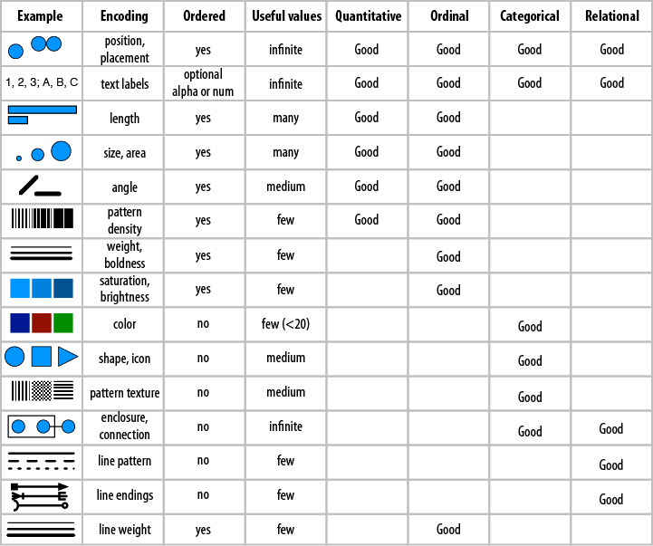
Motivation: why not just numbers?
Humans have evolved with excellent vision
Size and proportion
Space and spatial relationships
Colour
Approximate quantity
Humans have not evolved to read numbers or tables
In scientific publications and presentations, most people only look at figures

Slide 4
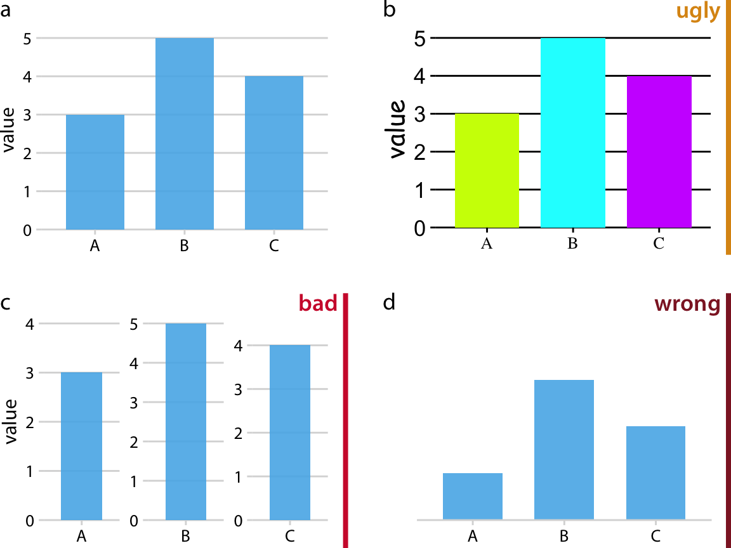
Motivation: what can go wrong?
ugly: A figure that has aesthetic problems but otherwise is clear and informative.
bad: A figure that has problems related to perception; it may be unclear, confusing, overly complicated, or deceiving.
wrong: A figure that has problems related to mathematics; it is objectively incorrect.

Slide 5
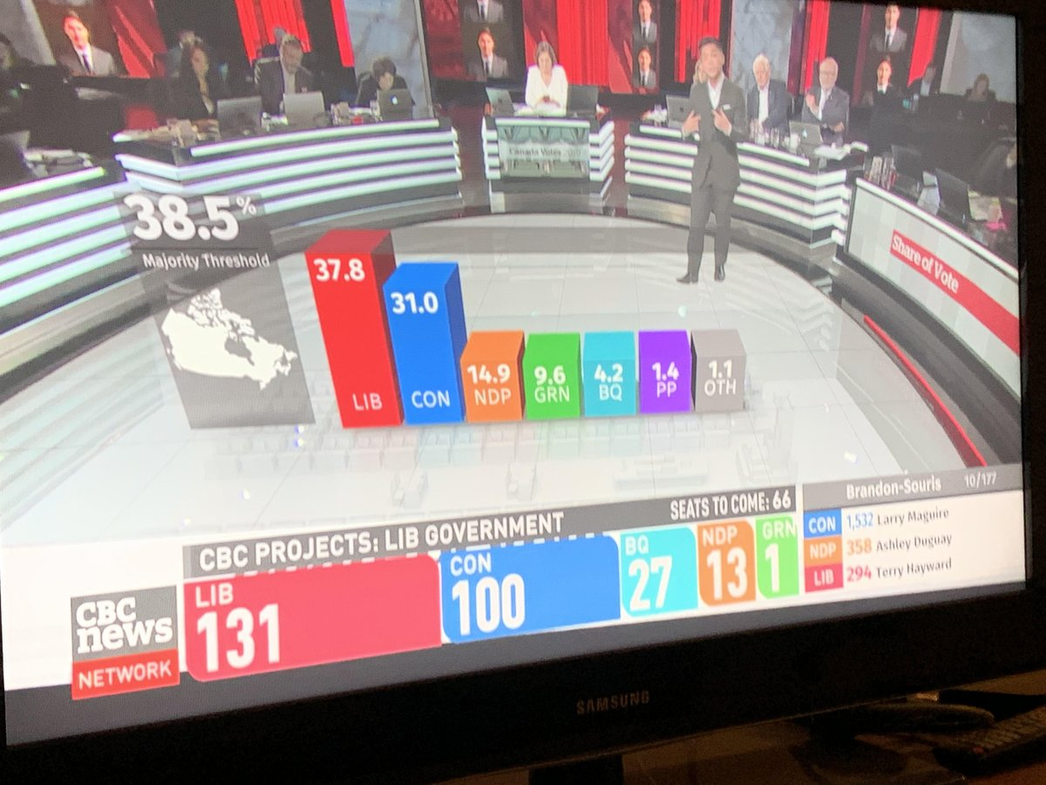
Motivation: what can go wrong?

Slide 6
Types of visualizations
Visualizing amounts: bar plots, grouped/stacked bars, dot plots, heatmaps
Visualizing distributions: histograms, density plots, boxplots
Visualizing proportions: bars, mosaic plots, tree maps
Visualizing x-y relationships: scatterplot, bubble chart
Visualizing geospatial data: choropleth, cartogram
Multi-panel figures
Many more: https://clauswilke.com/dataviz/directory-of-visualizations.html
Notes:
All very fluid. The same types of charts can be used for different purposes depending on what you’re trying to show. For instance, scatterplots can be used for almost any of these goals.
Plotting librairies we use will have support for many of these standard plot types. Documentation/examples to see how they’re used, don’t just guess!

Slide 7
Types of visualizations: activity (10 mins)
4 groups: amounts, distributions, proportions, x-y relationships
Pick 1 simple chart and 1 complex chart and show us:
Example use-case
What would be on the x/y axis
What other encodings (color, size) are used / can be used
Can they be made in Python? Find me some code samples
Present (no need to prep slides, walk through it while on the website)
Zoom breakout groups: I'll activate and assign topics via Slack
Directory of Visualizations
Don’t be afraid to Google the chart types to understand them better!

Slide 8
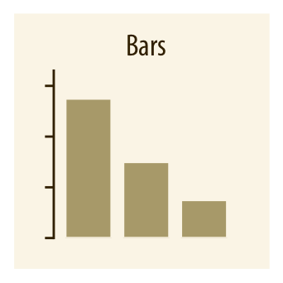
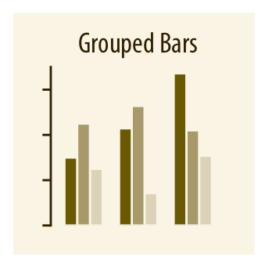
Types of visualizations: amounts
Simple Population of countries
Complex Sales by business unit by continent
x-axis: country
y-axis: population
color: emphasis on specific country
x-axis: continent
y-axis: sales in USD
color: business unit
Notes:
Question: How do you pick whether to within-group elements be different business units or different continents? What factors go into the decision?

Slide 9
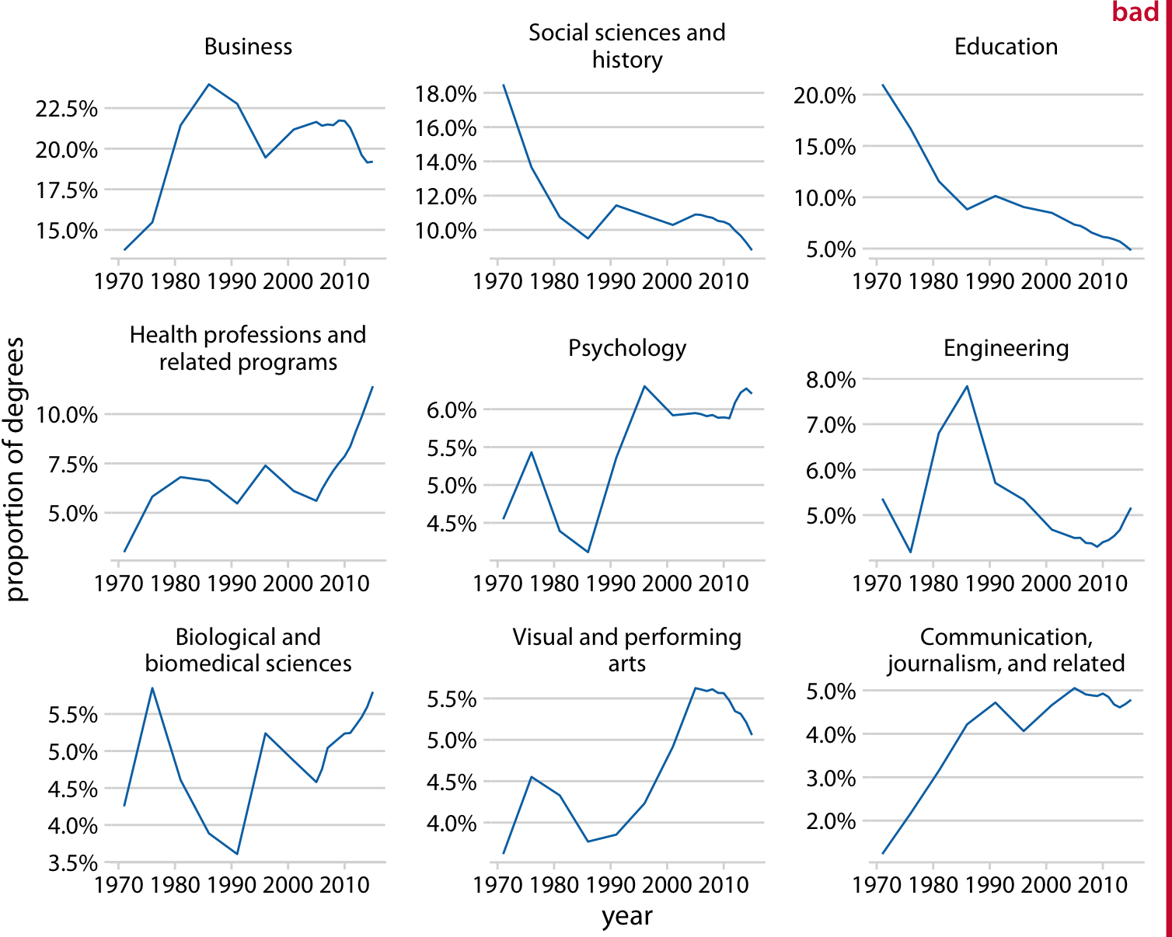
Types of visualizations: multi-panel figures
Notes:
Y-axis has to be the same

Slide 10
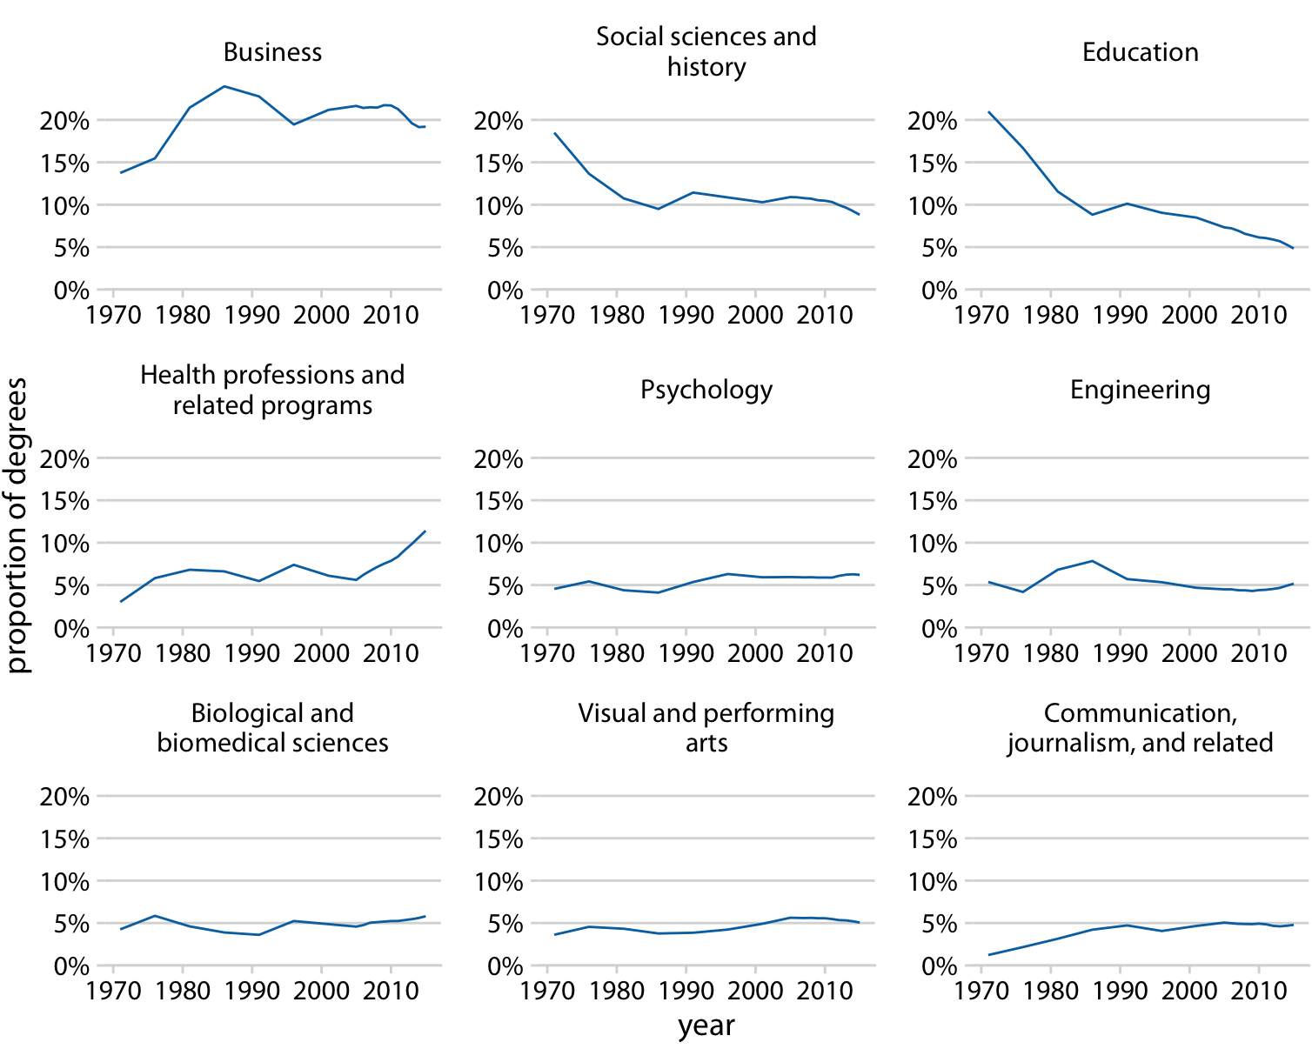
Types of visualizations: multi-panel figures

Slide 11
Design principles
Principle of proportional ink
Picking colours that have meaning
Use encodings to your advantage
Label clearly

Slide 12
1. The principle of proportional ink
The principle of proportional ink: The sizes of shaded areas in a visualization need to be proportional to the data values they represent.

Slide 13
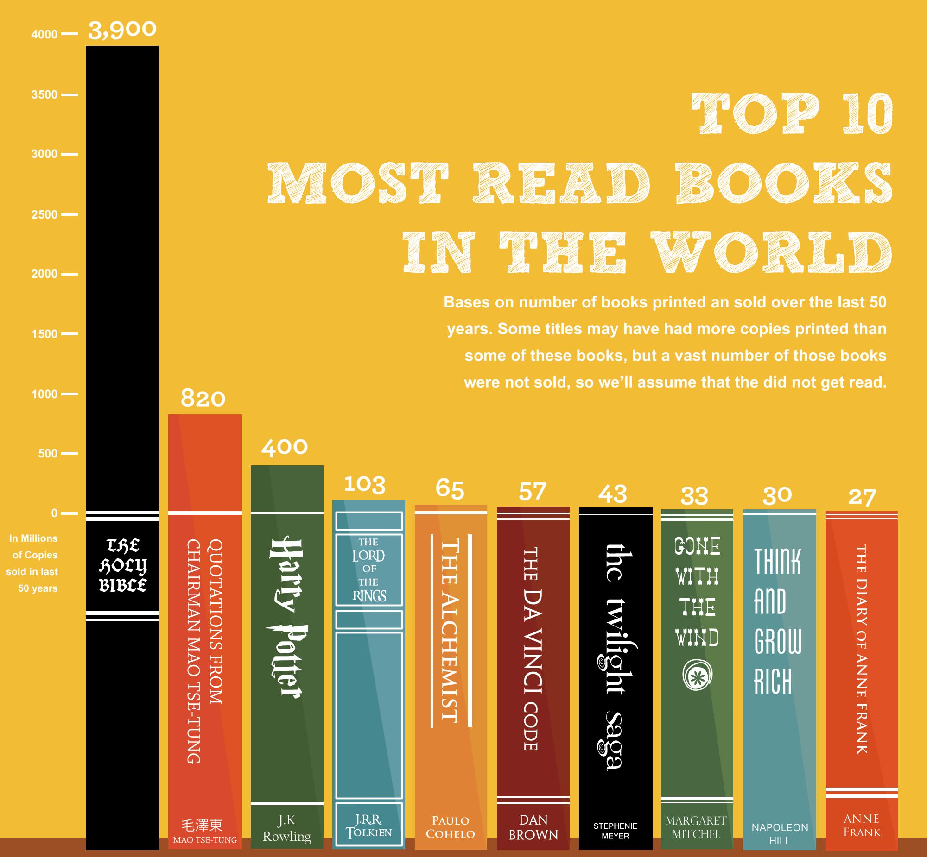
1. The principle of proportional ink

Slide 14
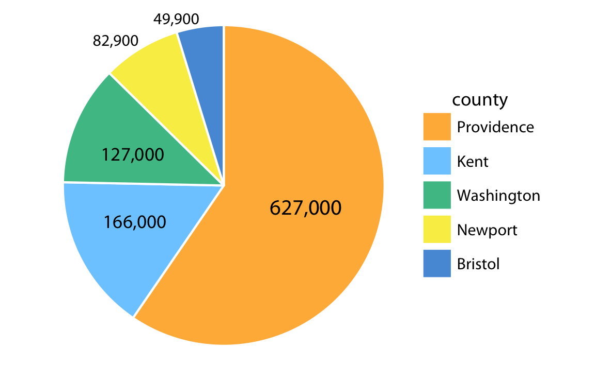
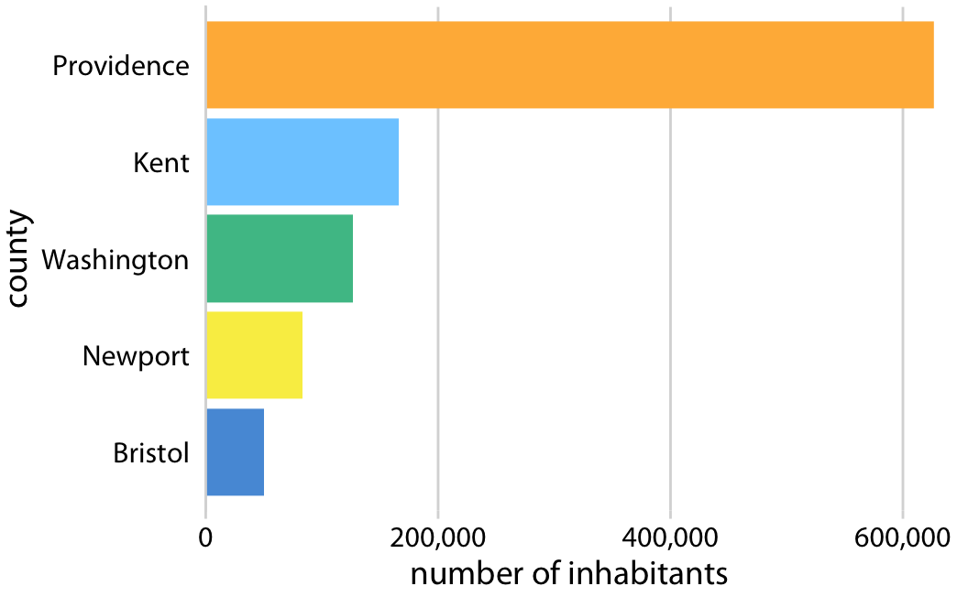
1. The principle of proportional ink

Slide 15
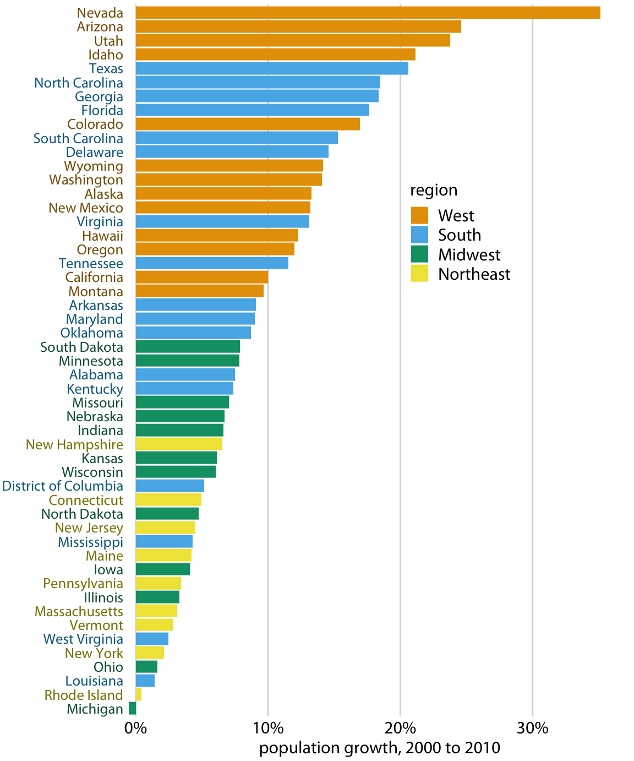
2. Using colour
Using color to represent discrete items or groups that don't have an intrinsic order

Slide 16
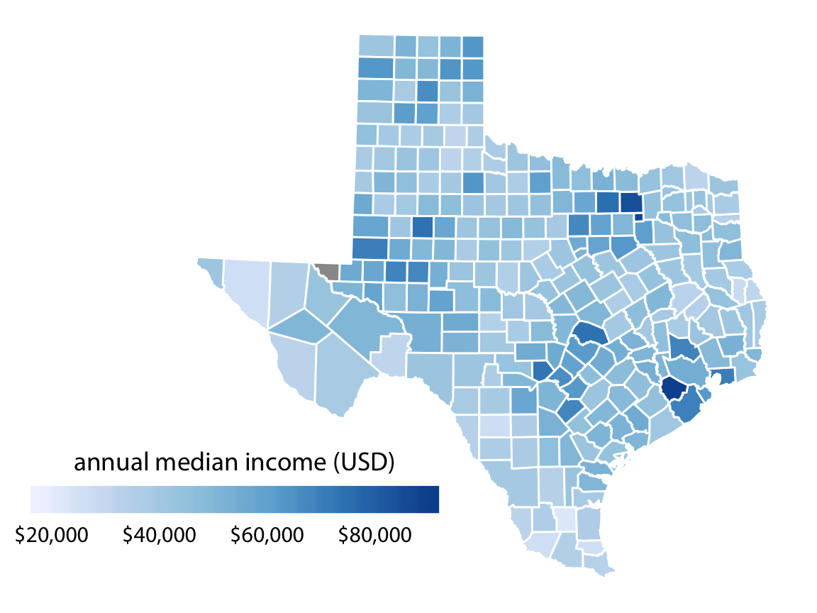
2. Using colour
Using color to represent data values on a sequential scale

Slide 17
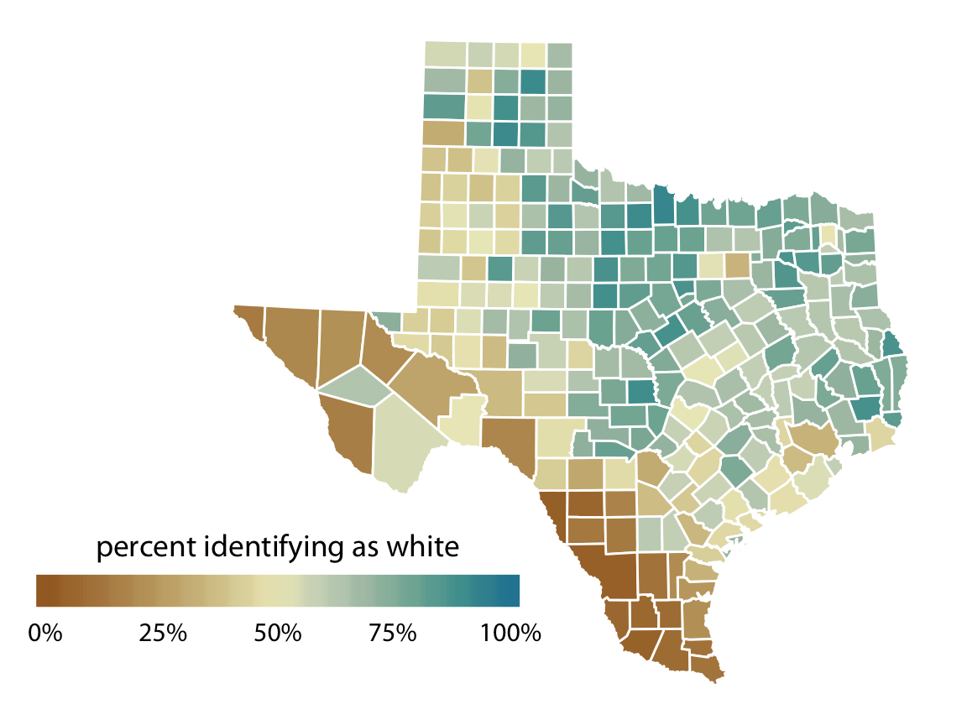
2. Using colour
Using color to represent data values on a divergent scale

Slide 18
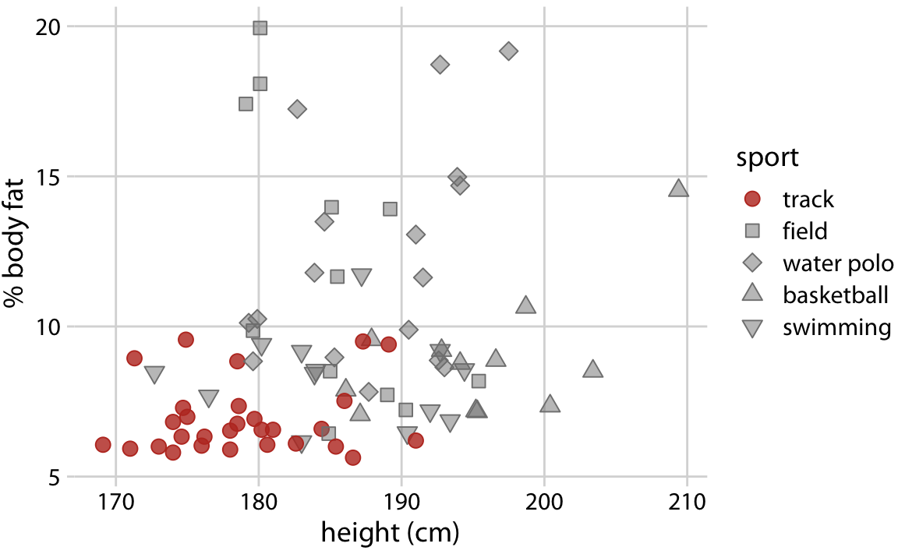
2. Using colour
Using color to highlight a particular group

Slide 19
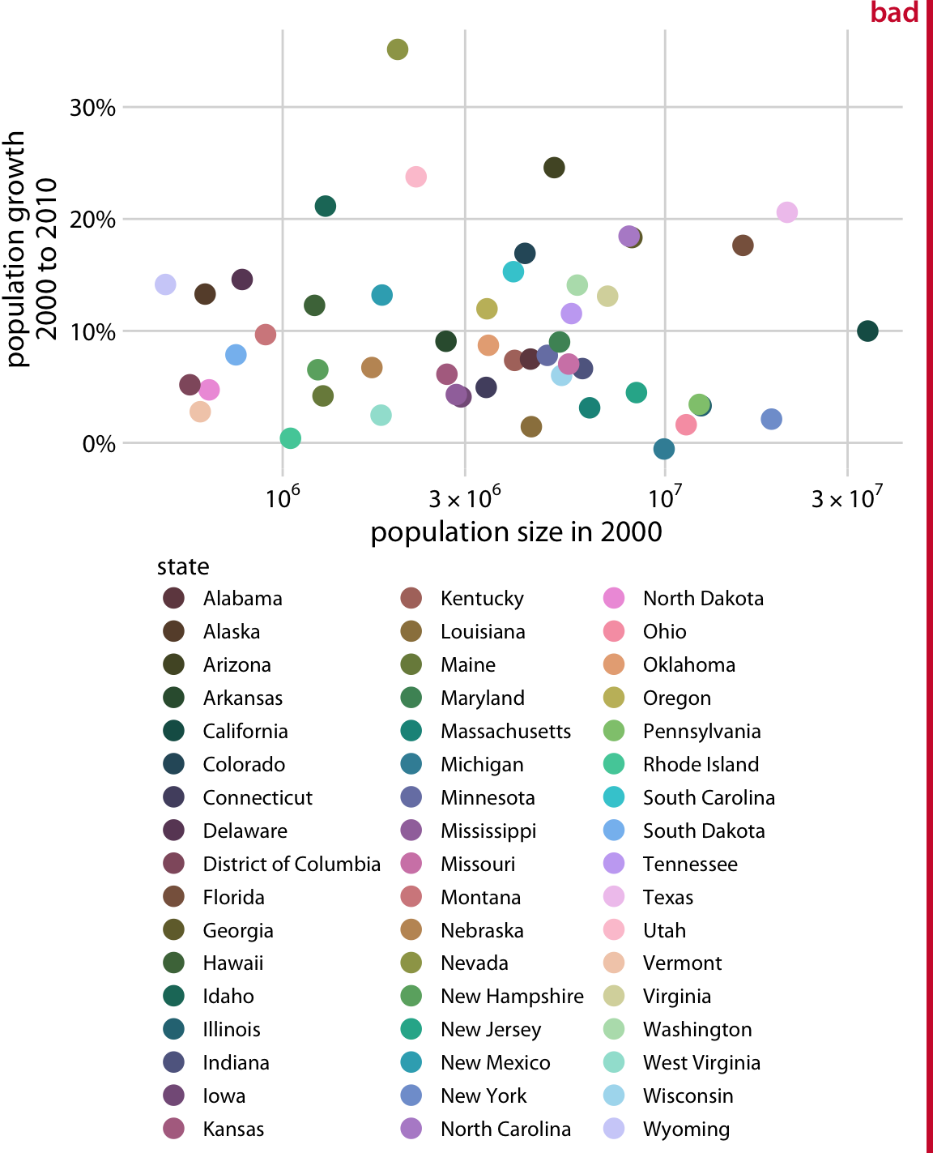
2. Using colour

Slide 20
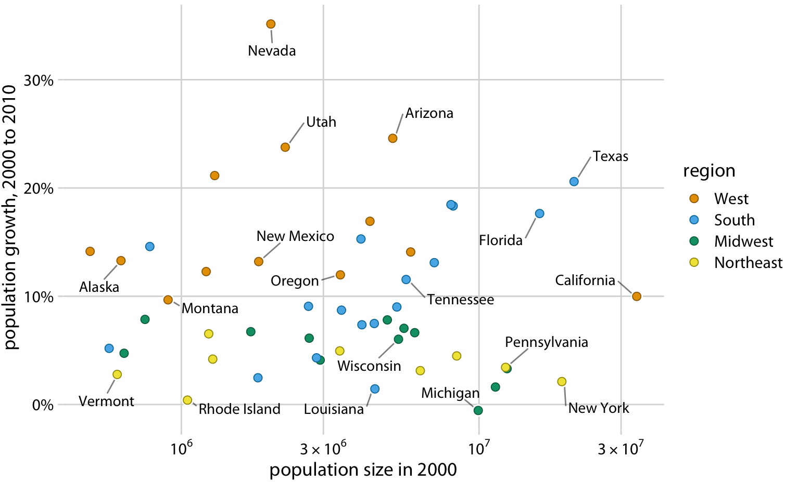
2. Using colour

Slide 21
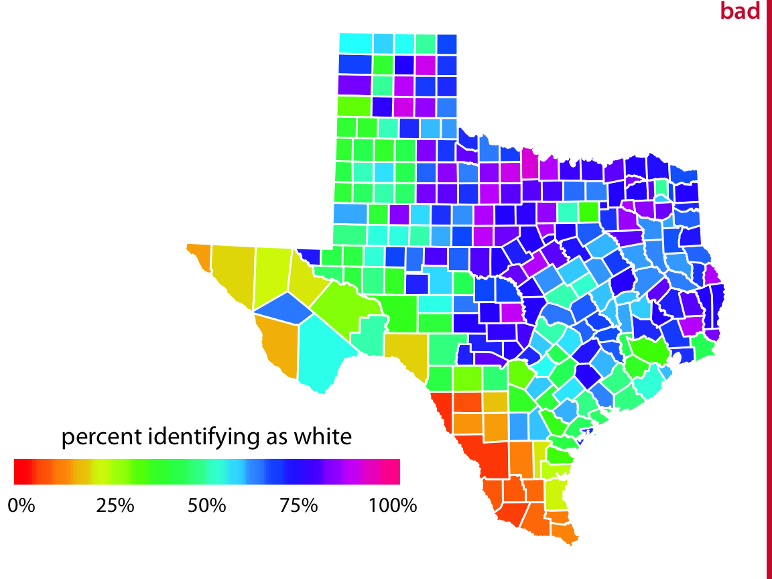
2. Using colour

Slide 22
3. Using encodings
Pick the right encoding for your purpose

Slide 23
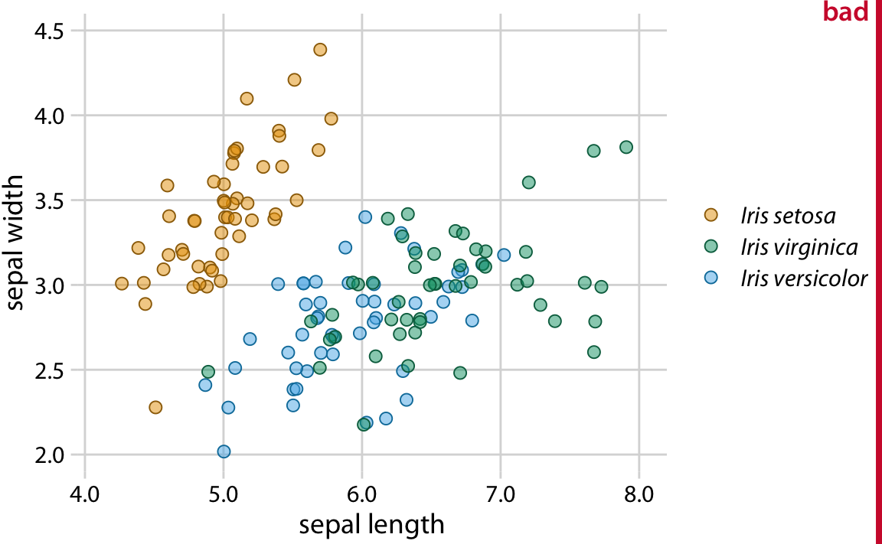
3. Using encodings

Slide 24
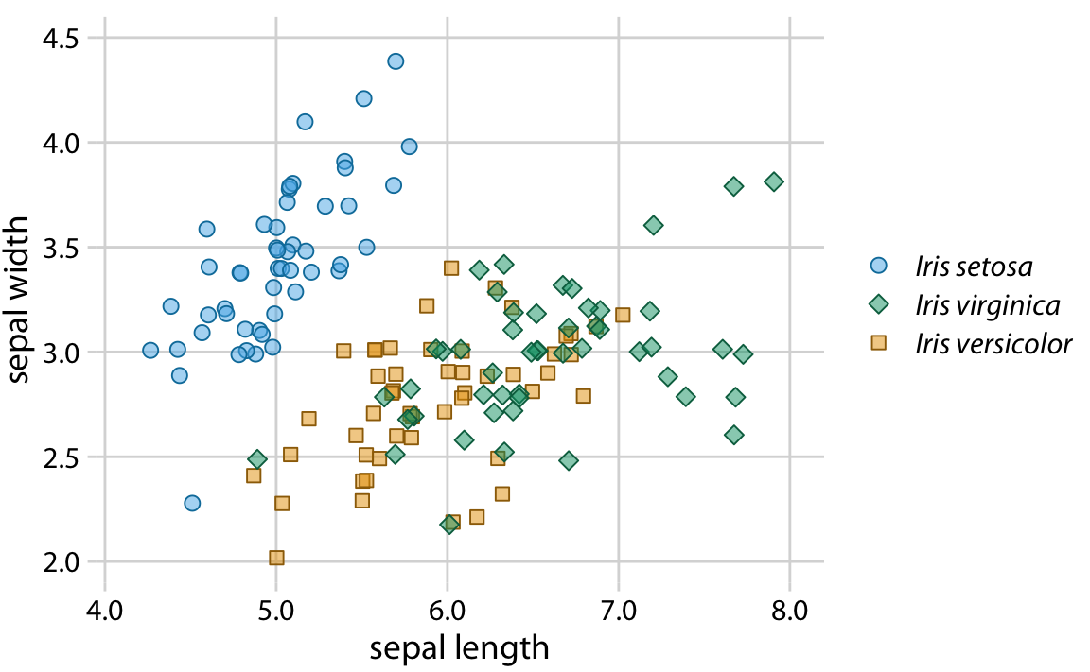
3. Using encodings
Redundant coding:
In cases of clutter
Color-vision deficiency
Grayscale (printing)

Slide 25
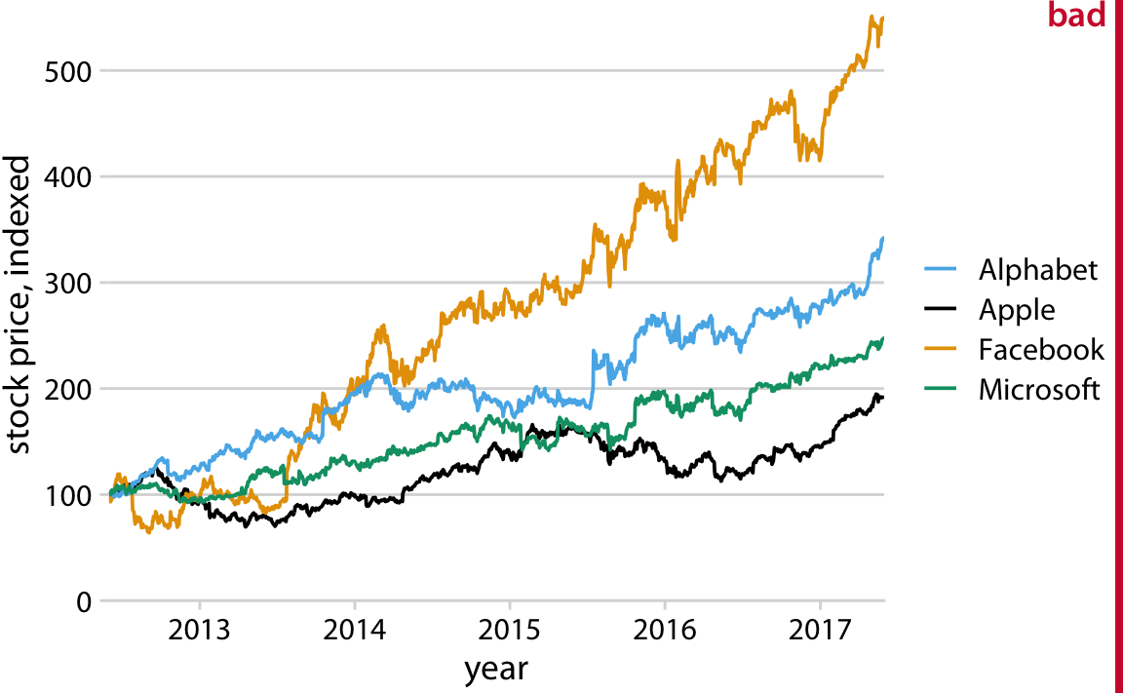
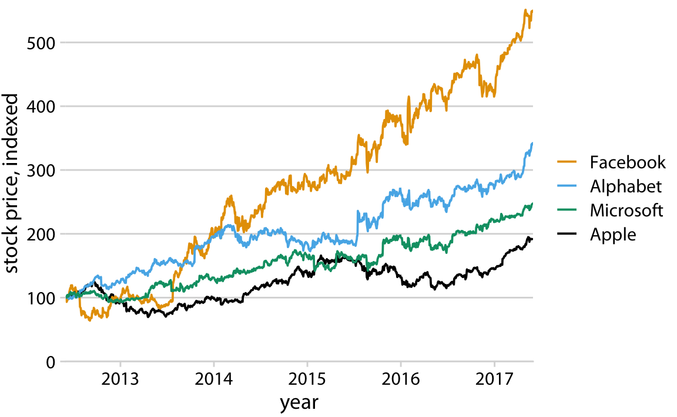
3. Using encodings
Redundant coding:
In cases of clutter
Color-vision deficiency
Grayscale (printing)
Notes:
There is an order

Slide 26
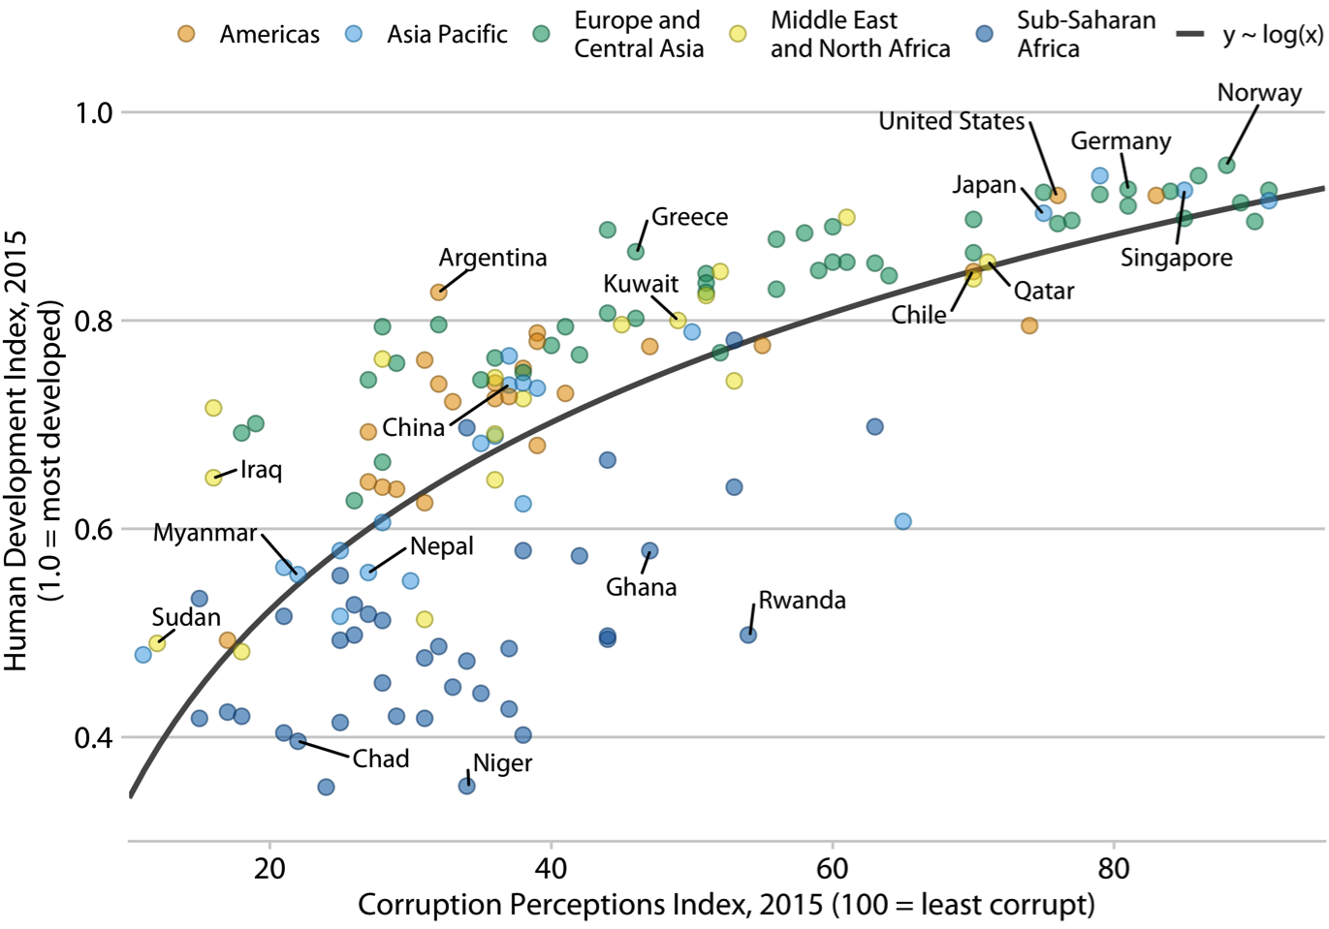
4. Label clearly
What does this figure show?

Slide 27
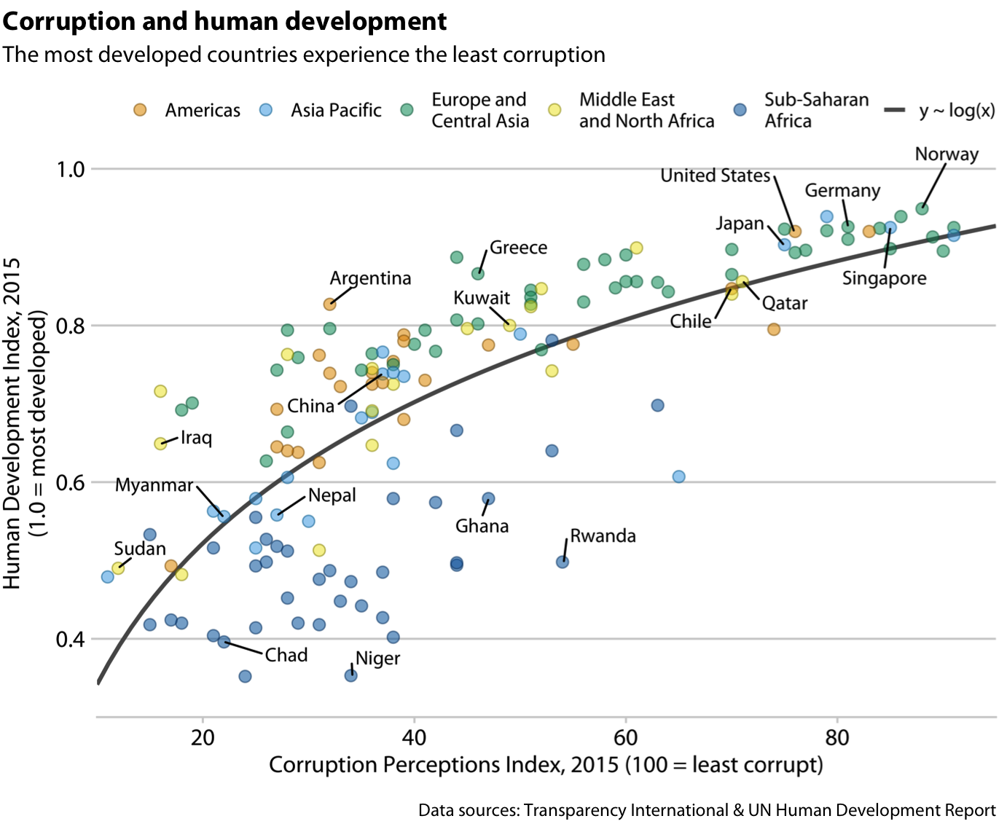
4. Label clearly
What does this figure show? A title can help give context
(especially when there is no figure caption).

Slide 28
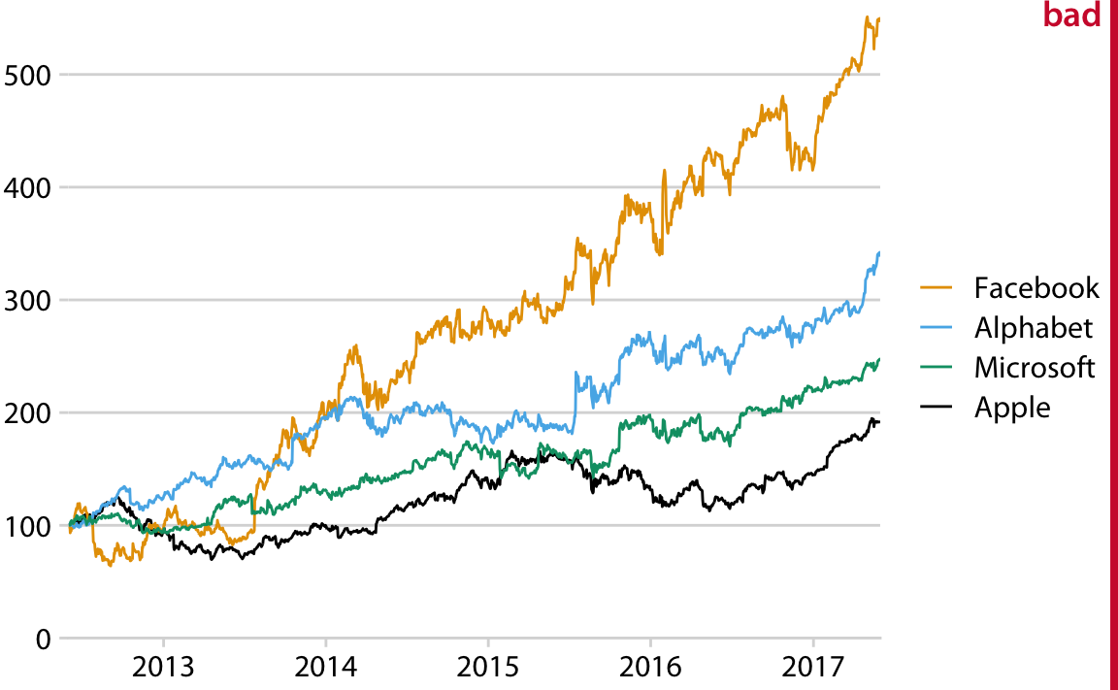
4. Label clearly

Slide 29
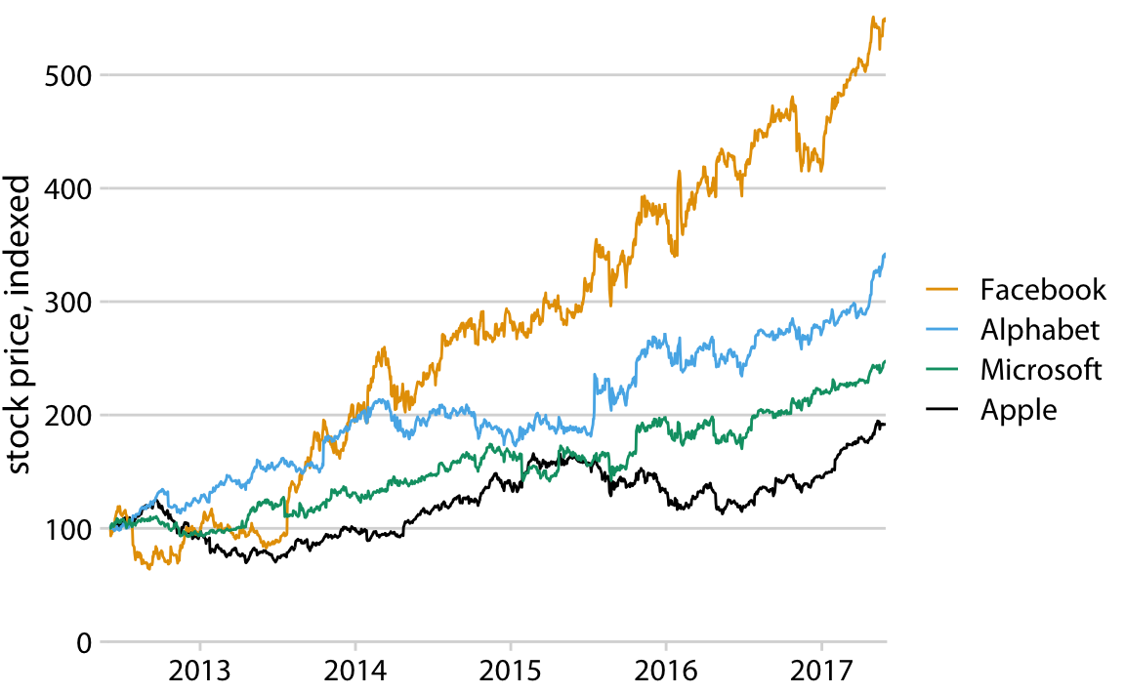
4. Label clearly

Slide 30
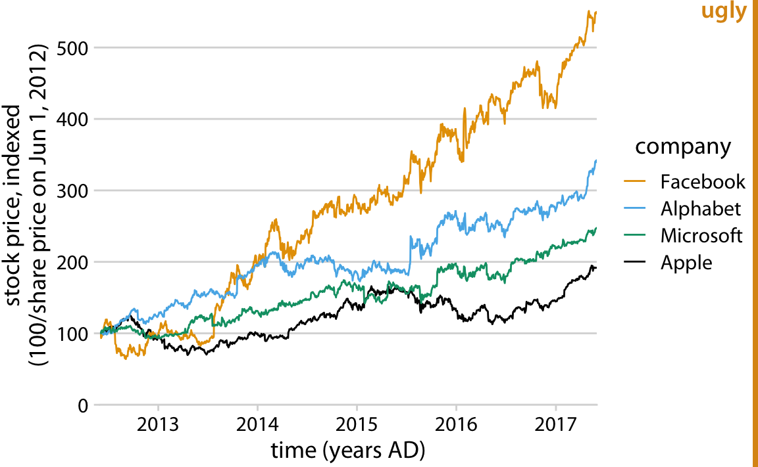
4. Label clearly

Slide 31
For more on data visualization
Fundamentals of Data Visualization
A guide for what plots to use based on the data format

Slide 32
Demo
https://github.com/EricElmoznino/lighthouse_visualization_tutorial

